Slide 1

Name: عبدالرحمن اشرف رجب محمد
ID: 20221374041
تكنولوجيا اللغة
Level:2

Slide 2
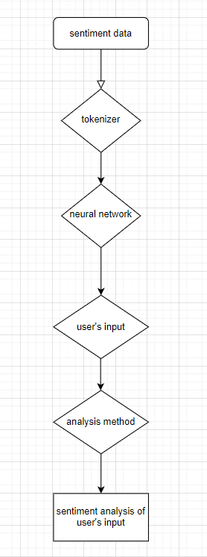

Slide 3
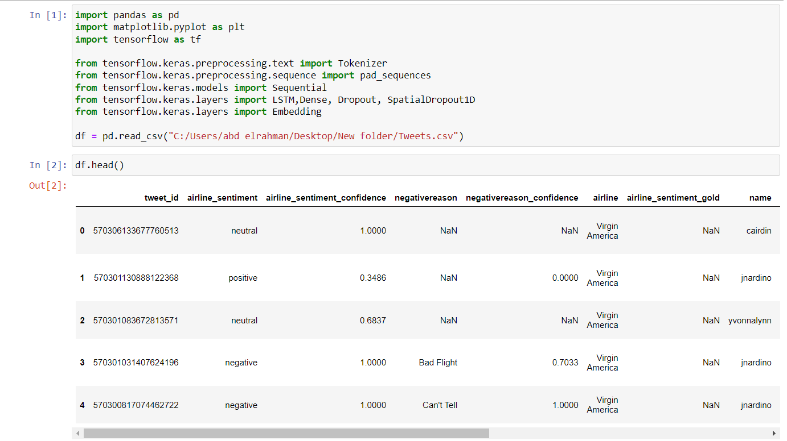
This program takes sentences as an input and the output is the sentiment analysis for the sentence.
This cell we acquired the data in it and we imported the libraries we will use in the program.

Slide 4
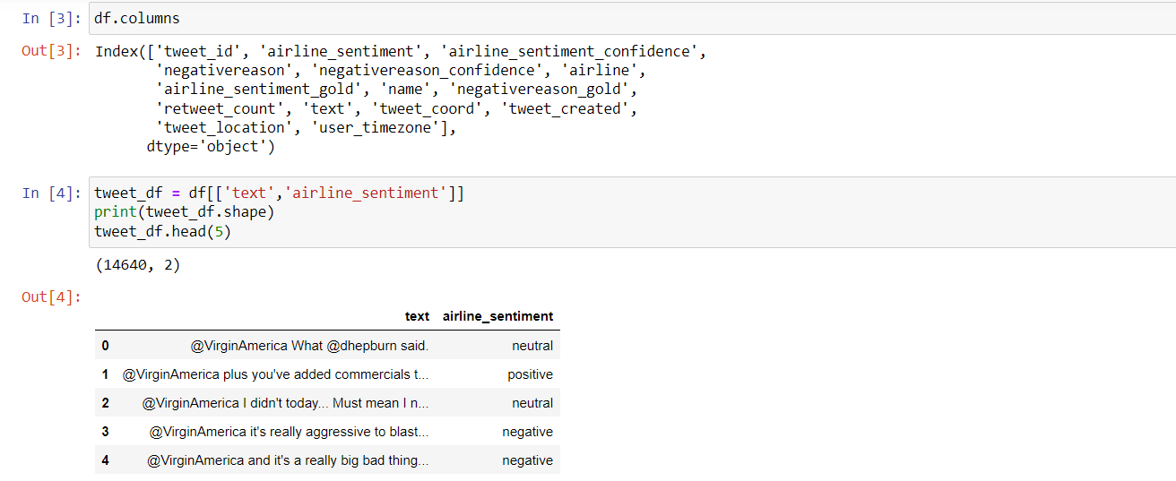
Here we see the columns names and we the first 5 raws of the text and airline sentiment coulmns

Slide 5
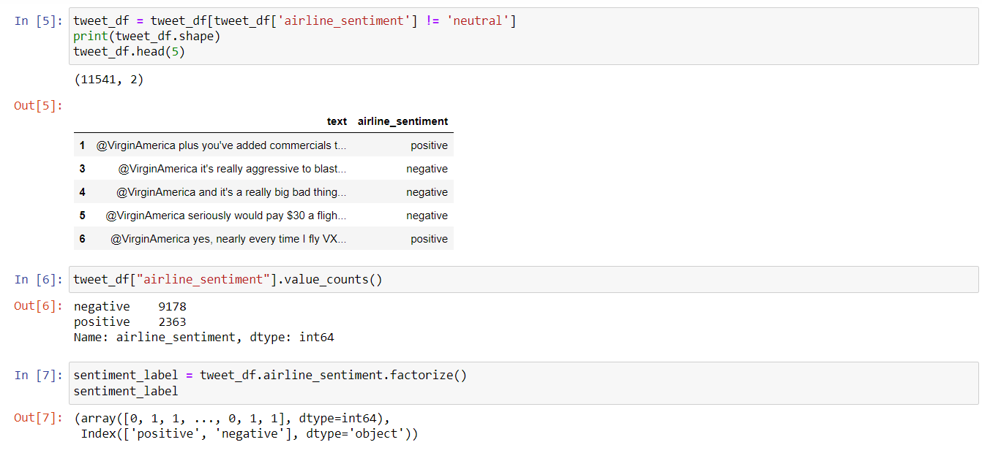
We exclude the neutral sentiment sentences from as data as we only need the negative and positive ones
We examine the negative and positive value count and we factorize it to use it in the neural network

Slide 6
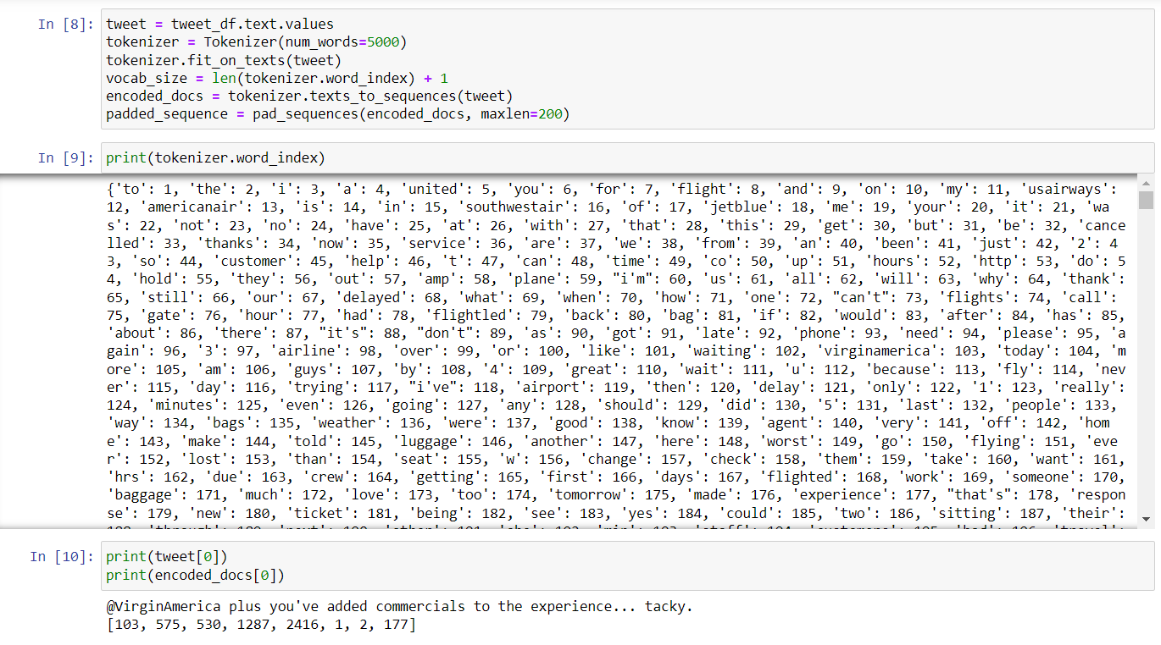
Here we tokenize each word in a tokenizer and fit it on our data
We make the pad sequences to be of max length 200
We tested the model on the first tweet of the data set

Slide 7
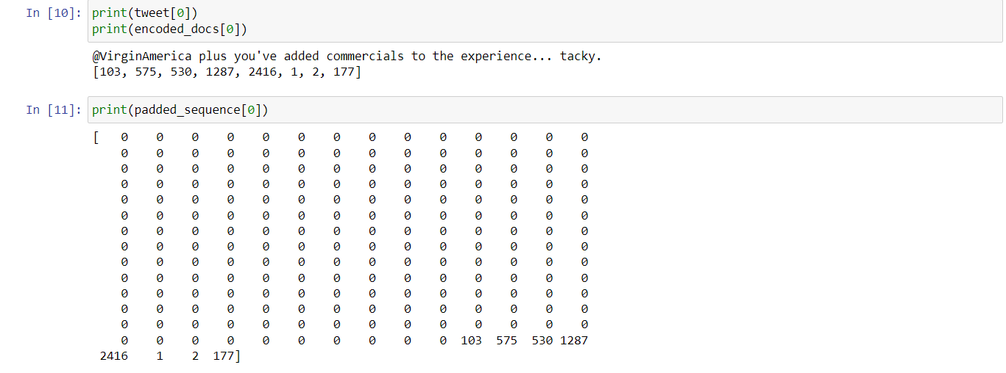
We test the padded sequence for the first sentence

Slide 8
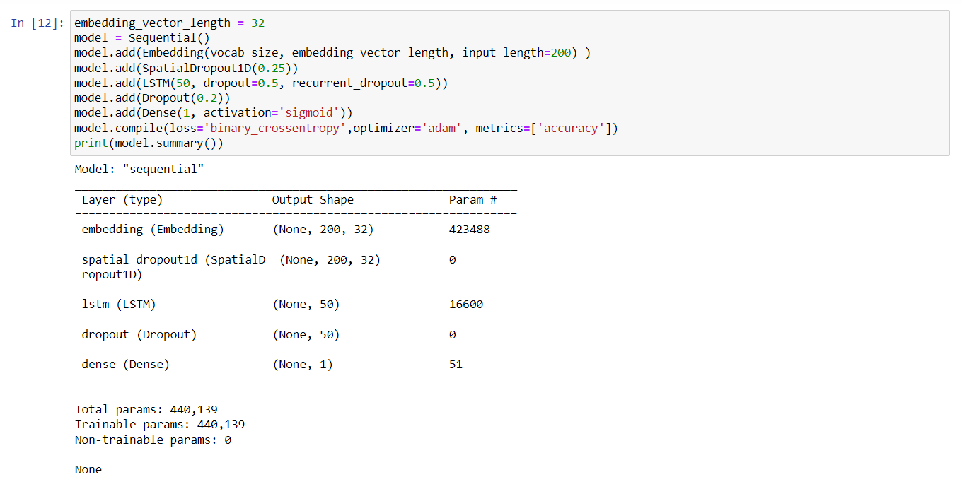
This is the neural network used in the program
Its model is sequential.
It has 2 neuron dropouts to solve the overfitting problem.
It uses sigmoid function

Slide 9
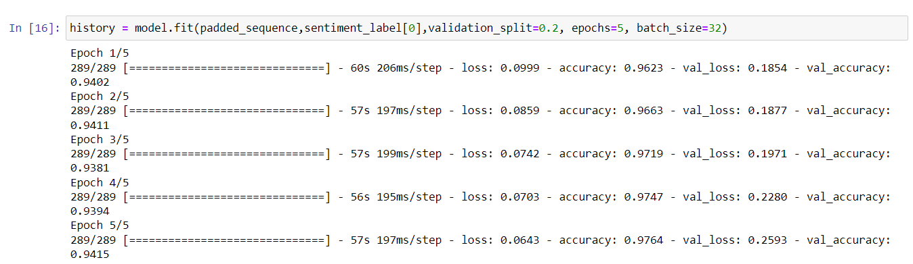
This is the learning part for the neural network
It will split the data 80% for learning and it will use 20% for testing
We got 97% percent accuracy from the learning process.
We conclude that the model is good to go.

Slide 10
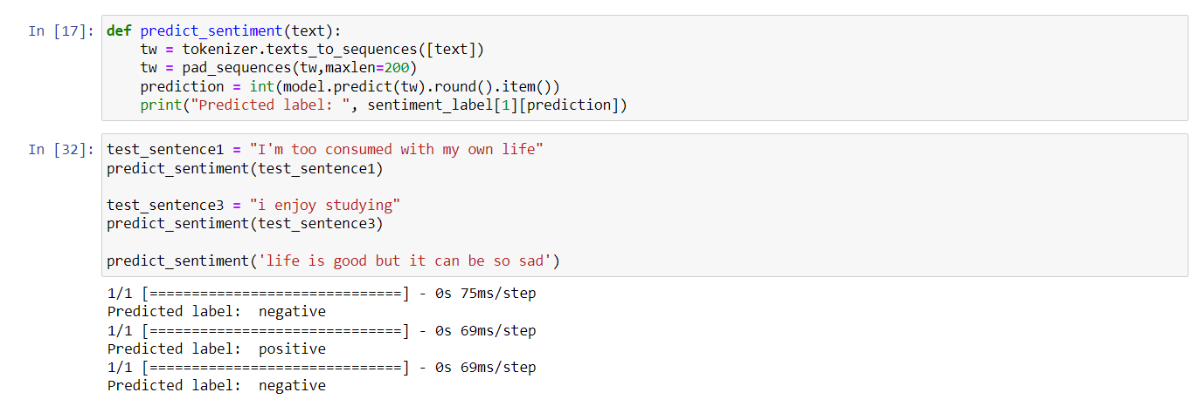
Here we define the sentiment analysis model and we test some statements
The program analysed the sentences right.

